Slide 1
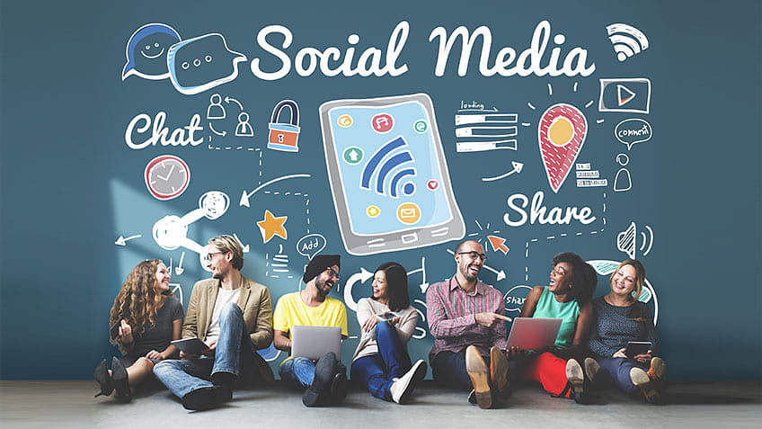
ETHICS ON SOCIAL MEDIA

Slide 2
Introduction
Social media is online platforms that facilitate the creation, sharing, and exchange of information and ideas through virtual communities. Examples include Facebook, Twitter, and Instagram. It has profoundly transformed communication, influencing public discourse, and is an integral part of daily life, shaping social interactions and information consumption.
Ethics in social media involve respecting user privacy, fostering inclusivity, and promoting truthful information dissemination to ensure a responsible and positive online environment.

Slide 3
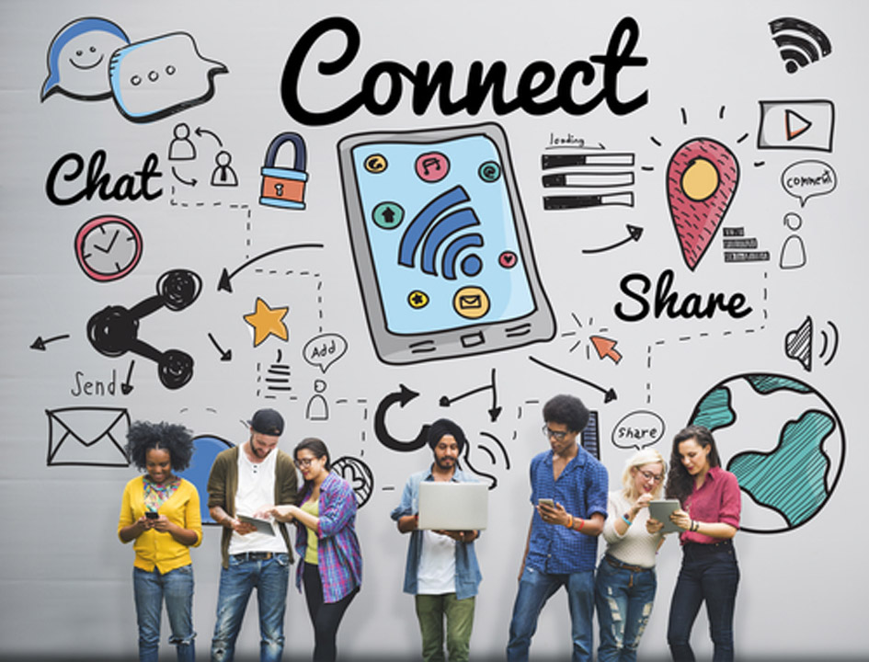
The Power of Social media
Reach and Speed of Information Dissemination:-Social media enables the rapid spread of information globally, allowing news, trends, and messages to reach a vast audience within seconds. This speed can be a force for good, facilitating the rapid dissemination of important information, but it also poses challenges such as the swift spread of misinformation.

Slide 4
Influence on Opinions and Behaviors:- Social media platforms wield significant power in shaping public opinions and influencing individual behaviors. The ability to share diverse perspectives and engage in discussions can lead to the formation of new ideas and perspectives.
Potential for Positive and Negative Impact:- The power of social media lies in its dual potential for positive and negative impact. It can be a catalyst for positive social movements, awareness campaigns, and community building. However, it also harbors the risk of spreading misinformation, fueling online conflicts, and contributing to the amplification of harmful narratives. Responsible use is crucial to harness its power for positive change.

Slide 5

Ethical Behavior
Transparency and Honesty
Example:- Companies that openly communicate with their audience and respond to customer inquiries transparently are exhibiting ethical behavior.
Promoting Diversity and Inclusion
Example:- Social media can be used to promote diversity and inclusion. Companies that actively showcase their commitment to diversity, share diverse stories, and celebrate cultural events contribute positively to the ethical use of social media.

Slide 6

Unethical Behavior
Fake News and Misinformation
Example:- The spread of false information and fake news on social media platforms can have severe consequences.
Cyberbullying
Example:- Harassing or bullying individuals on social media platforms is a clear example of unethical behavour.

Slide 7

Social Media Addiction
Social media addiction refers to the excessive and compulsive use of social media platforms, leading to negative impacts on one's physical and mental well-being. It often involves a constant need to check and engage with social media, neglecting real-life activities and relationships.
This addiction can contribute to issues such as decreased productivity, sleep disturbances, anxiety, depression, and a distorted sense of self-worth influenced by online interactions.

Slide 8
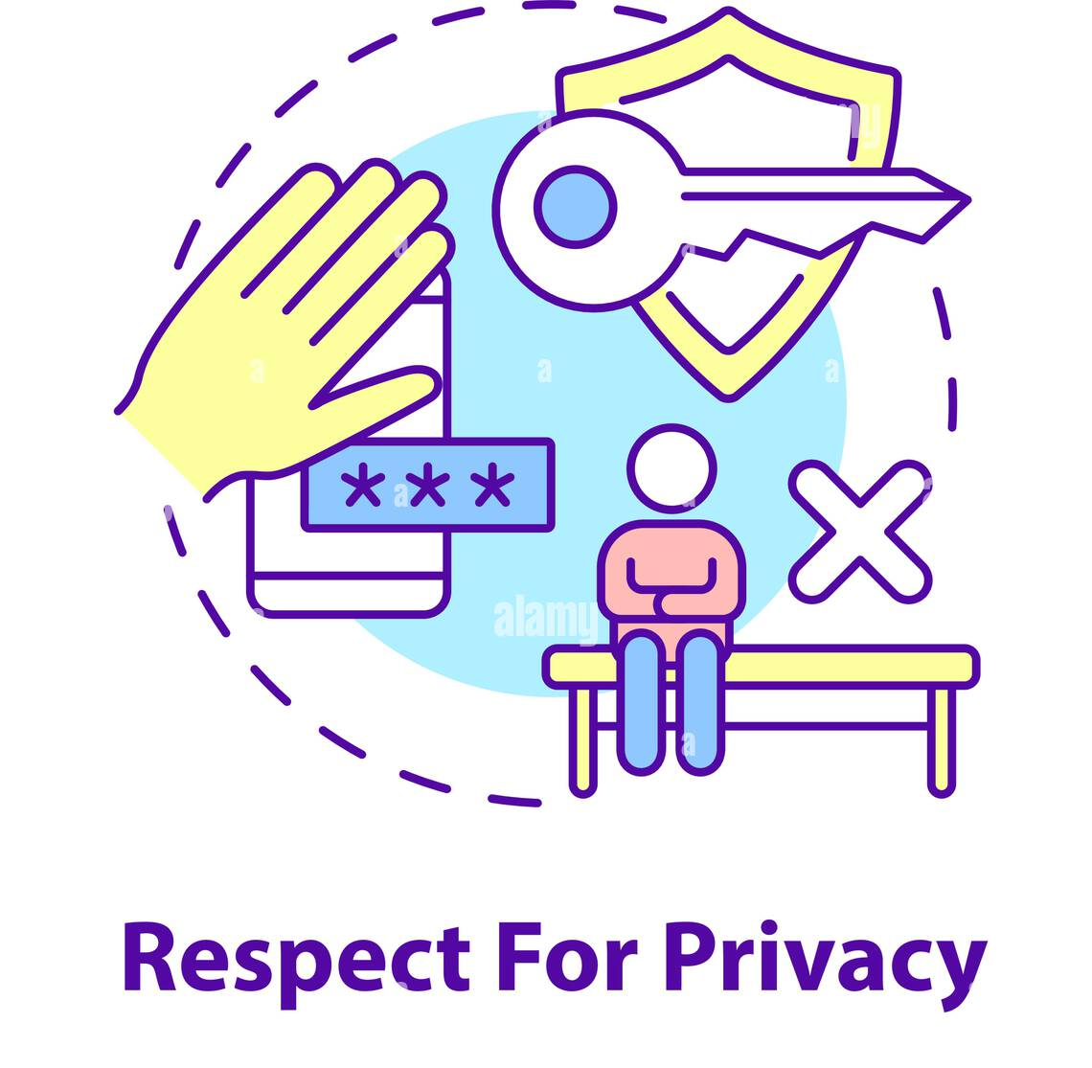
Ethical guidelines for users
Respect Other’s Privacy
Avoid sharing personal information about others without their consent.
Respect the privacy settings and preferences of individuals on your friends' list or in your network.

Slide 9

Promote Positive Interactions
Avoid engaging in online bullying, harassment, or any form of cyberbullying.
Foster a positive online environment by encouraging support and understanding.
Think Before You Post
Consider the potential impact of your posts on yourself and others.
Be aware that content shared on social media can have long-lasting consequences.

Slide 10
Educating the Next Generation involves
Integrating Digital Literacy into Education:-This involves incorporating skills such as information literacy, online research, and basic computer proficiency into the curriculum. Students learn how to navigate digital platforms, use online tools effectively, and critically evaluate information found on the internet.
Teaching Responsible Social Media Use:- This focuses on educating students about the impact of social media on personal and societal well-being.Emphasis is placed on cultivating responsible online behavior, understanding the consequences of digital actions, and promoting positive digital citizenship.

Slide 11
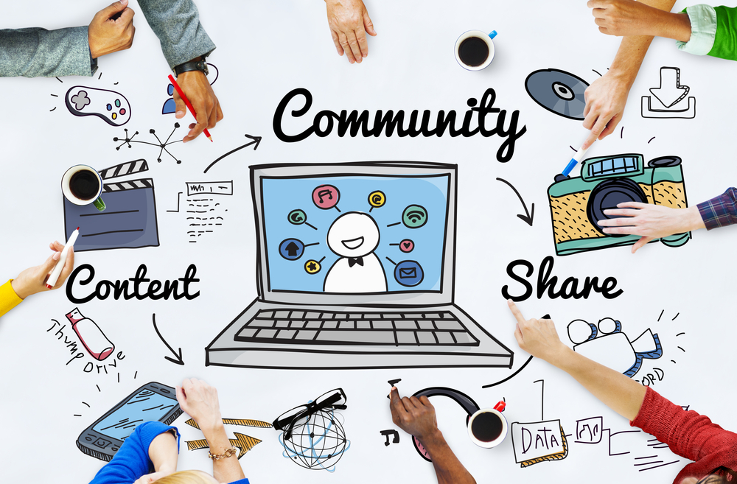
CONCLUSIONS
Social media ethics promote welcoming and secure online environments.
Users are more trusting when data is handled responsibly and is transparent.
When social media is used responsibly, it can be a very effective tool for good in society.

Slide 12
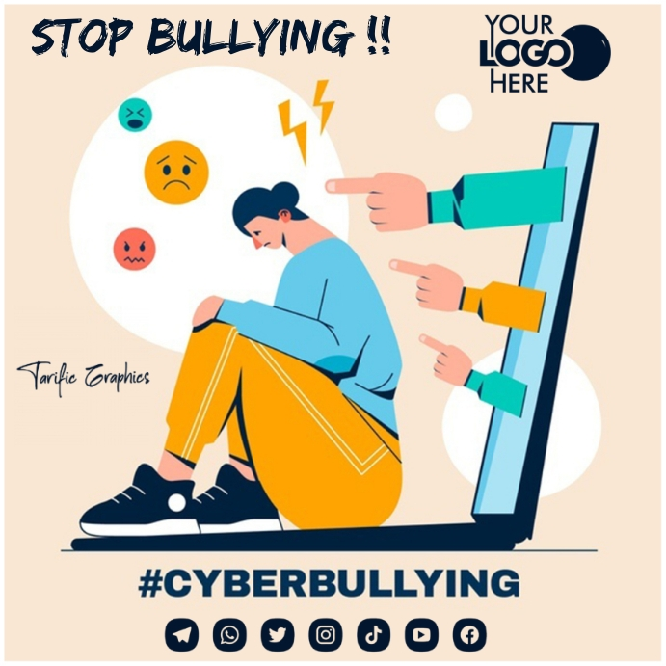
Global connections are made possible by it, and voices that might otherwise go unheard are amplified.
The significance of ethical considerations is underscored by misinformation, cyberbullying, and privacy concerns.
The necessity of taking preventative action is highlighted by political manipulation and other issues.

